Slide 1
Co-dfns Report
Dyalog ‘23 – Aaron Hsu – aaron@dyalog.com

Slide 2
Agenda
Lots of new people are here, so let’s set the stage…

Slide 3
What
01
Why
02
Table of contents
Status
03
How
04
What is Co-dfns?
Primary goals of the project
Progress report and update
A short primer to get started

Slide 4

01
Why
What are the goals of the project?

Slide 5
Problem
How do we expand the capabilities of APL so that it can be used by more people in more places for more problems?

Slide 6
Solutions?
Performance
Integration
Research
Education
Make APL faster for more problem domains
Make APL easier to integrate into your stack
Tackle hard problems using APL
How can people learn to use APL in more ways?

Slide 7
Some history
2015
2010
Is a self-hosting GPU compiler even possible?
Is APL even a viable language anymore?

Slide 8
Some history
2020
2022
APL is cool, but is it fast?
How do I use this Co-dfns thingie?

Slide 9

02
What
What is the Co-dfns project?

Slide 10
Co-dfns
A compiled APL implementation…
Written in APL
Compiles to the GPU
Designed to self-host on the GPU
Integrated closely with the interpreter

Slide 11
1401
824
8418
APL Compiler Source Lines of Code
APL Runtime Source Lines of Code
C Kernel Source Lines of Code

Slide 12
Co-dfns features
Hackability
Offline Parser
Portability
Written in APL
Makes it easy to extend, change, and update
Static analysis, type checking, learning, etc.
Performance portable runtime and APIs
Demonstrates APL applied to non-traditional domains

Slide 13
03
Status
What’s been kickin’ chicken?

Slide 14


Slide 15
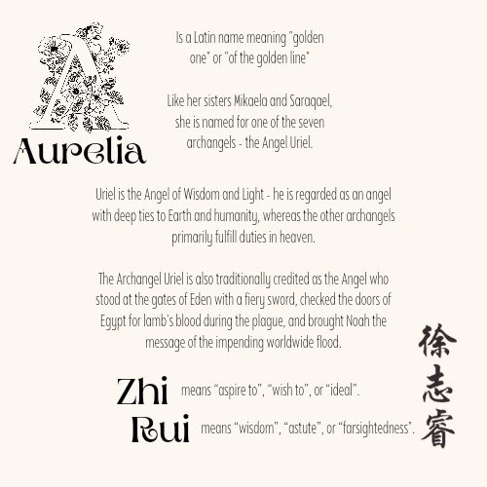

Slide 16
v4
Upcoming V5+
High performance on GPUs
Limitations in core array functions
Errors can be opaque and confusing
Not easy to retarget
Non-GPU workloads can be slow
Full core language support
Much better errors
Faster for more workloads
Target more backends (JS, C, WASM)

Slide 17
Progress
Finished
Doing
Upcoming
APL runtime rewrite
APL in APL (Primitives)
Parsing/Debugging Updates
Core performance tweaks
Runtime hardening
New feature verification
New backend ports Integration tutorials

Slide 18

Assumptions
Dfns
Namespace
Core only
No error guards
Full support for operators
One top-level namespace
Closed (no global refs)
No system functions, spanw&, etc.

Slide 19
Primitives
Datatypes
Language
Nested Arrays
High Rank
All the “core” squiggles
(⌸ @ ⌺)
bool8, int16, int32, float64
char8, char16, char32
Complex
Full support for nested arrays
Host allocated
Ranks of any size

Slide 20

Limitations
Selective Assignment
Trains
Trad-fns
Error guards
Inverse
Execute
⎕IO
Format
@ ⌸ (“New” squiggles)

Slide 21
Cool Stuff
I-Beam FFI
Auto-GPU
Axis for All
Integration
Embeddable
Errors
Platform Portable FFI
No need to manage GPU manually
Any dfn can receive an axis
Directly with DWA
Easy C API
Runtime is lightweight and embeddable
Rich error messages and TBT stack traces

Slide 22
Future Work
Performance
Moar!
Small Arrays
Fast “utility” functions
Events/GUI
Reactive APL
Javascript
“Isomorphic” APL

Slide 23
Known Regressions
Axis Op
Nested
Rank
Characters
Some primitives missing support
Bug in stranding
Rank is broken right now
DWA import/export isn’t working yet

Slide 24
04
How
How do I use Co-dfns?

Slide 25
Installation
Co-dfns
Depends On
Compiler
OS Compiler
ArrayFire
Runtime
Core

Slide 26
OS compiler
Install Steps
ArrayFire
Co-dfns
Visual Studio, GCC, Clang
Make sure the PATH is set!
Grab it from Github

Slide 27
MK∆RTM
Fix
Builds your runtime for your OS/compiler
Ship the codfns.dll with your app
‘fname’codfns.Fix ⎕SRC namespace
Produces a fname.dll
Links fname.dll into your workspace

Slide 28



Shipping/Distribution
Af*.dll
Module.dll
ArrayFire runtime used by codfns.dll
The DLL you build for your code via codfns.Fix
Codfns.dll
Dyalog NS
Modules are linked and built against this DLL
The namespace created by codfns.Fix if needed

Slide 29
Demo(-lition)

Slide 30
Linux Gotcha
LD_LIBRARY_PATH=.:/opt/arrayfire/lib64
$ echo /opt/arrayfire/lib64 > /etc/ld.so.conf.d/arrayfire.conf
$ sudo ldconfig

Slide 31
Thanks
Questions?
aaron@dyalog.com

